Slide 1


www.hologen-network.org
Advancing the development and implementation of hologenomics in biological sciences
Funded by the European Union under Grant Agreement 101169005

Slide 2
www.hologen-network.eu
Training and Networking Retreat 1
Torgeir R. Hvidsten
Norwegian University of Life Sciences

Slide 3
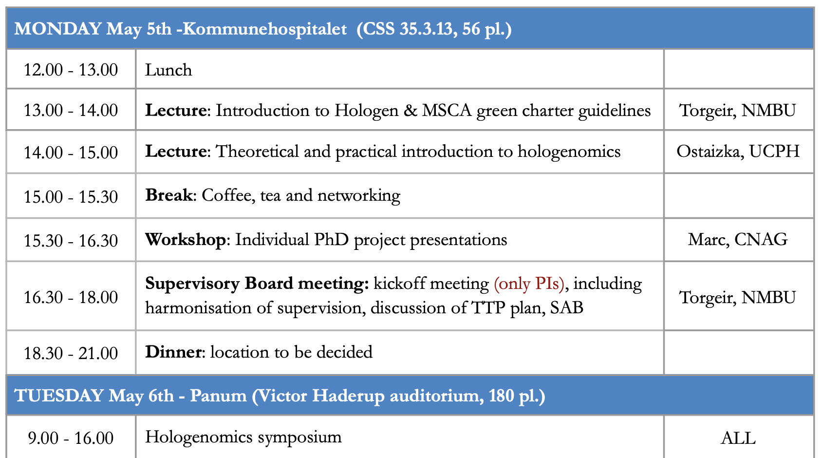
www.hologen-network.eu
Program

Slide 4
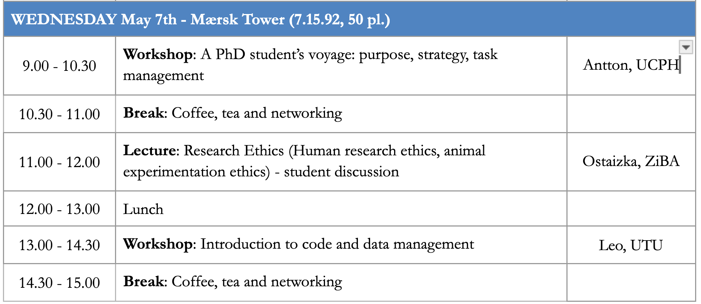
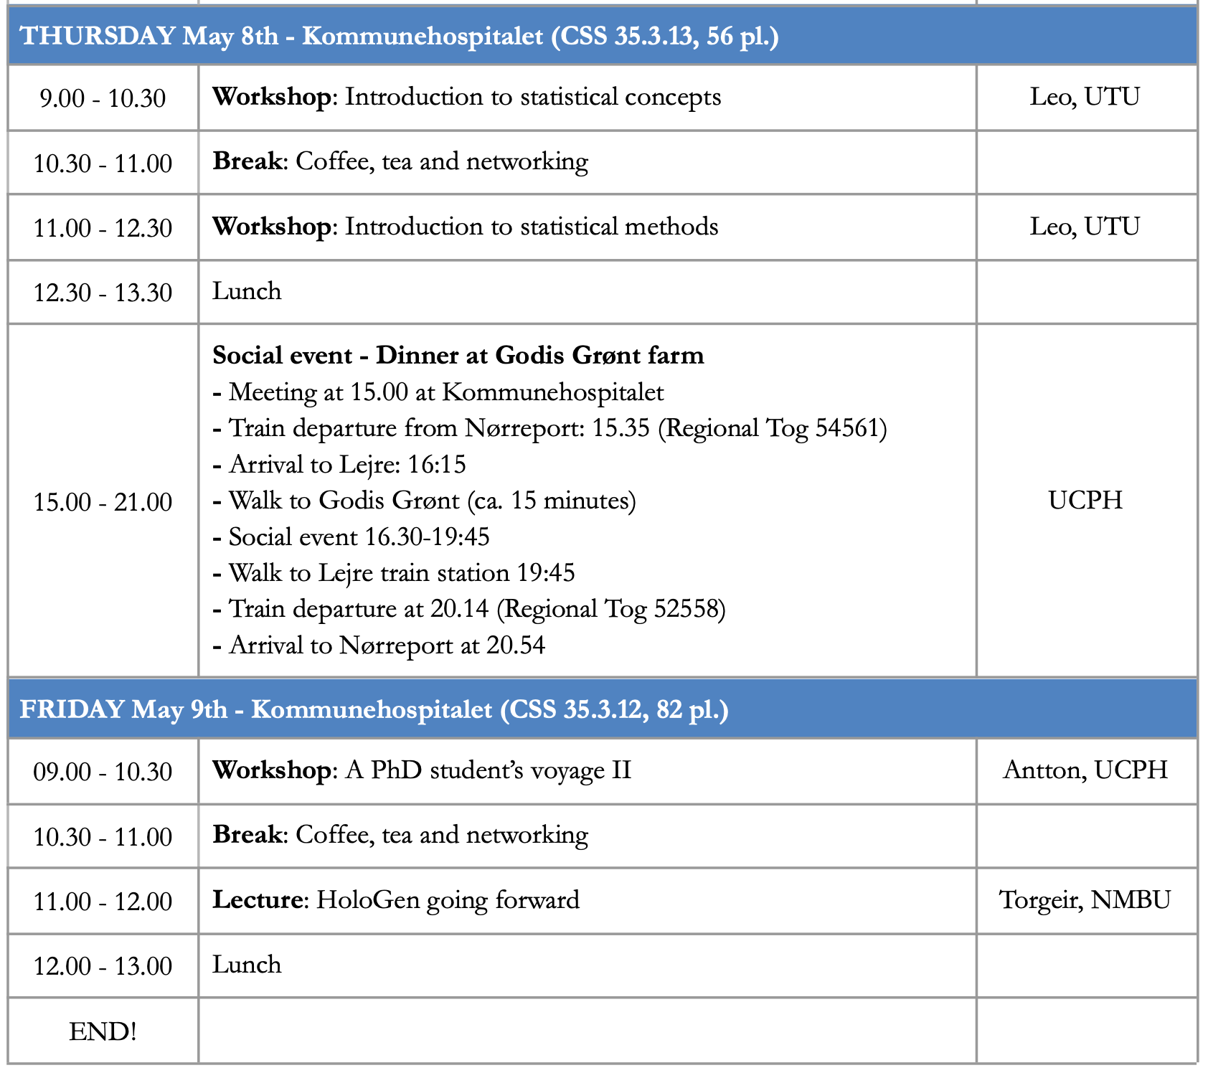
www.hologen-network.eu
Program

Slide 5

www.hologen-network.eu
MSCA Doctoral network
The MSCAs are the European Union’s flagship programme for doctoral education and postdoctoral training.
Excellence, mobility, supervision, career guidance, open science, …

Slide 6
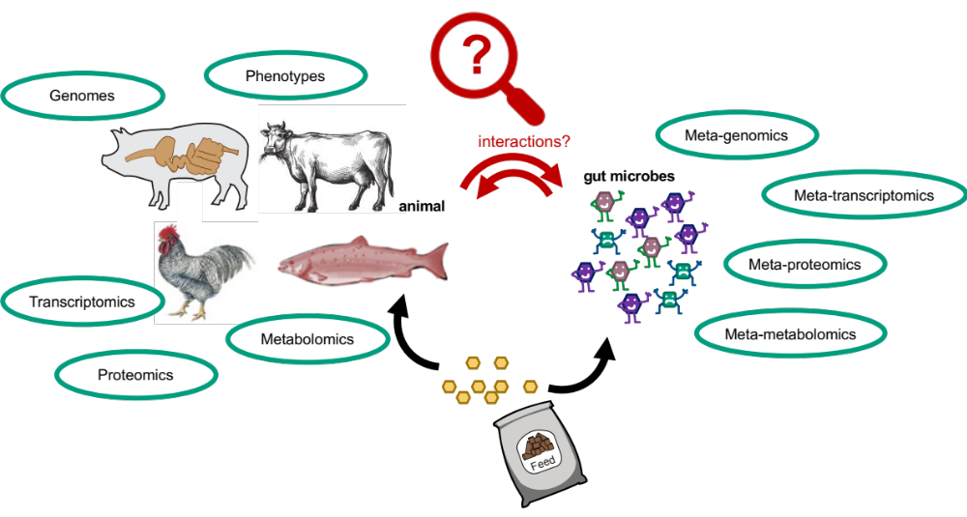
www.hologen-network.eu
Hologenomics

Slide 7
www.hologen-network.eu
HoloGen objectives
Strategic objectives
SO1 | Train the next generation of multidisciplinary scientists
SO2 | Strengthen both European industry and academia with a cohort of talent
SO3 | Produce a large number of high-profile publications
SO4 | Enable long-term transfer of technological gains to and from industry partners
Research objectives
RO1 | Develop novel computational approaches
RO2 | Understand fundamental principles of biochemical and ecological interplay
RO3 | Apply the hologenomic framework
Training objectives
TO1 | Understand the relevance of host-microbiota interactions and master the appr. of hologenomics
TO2 | Develop skills in quantitative analysis and management of big data
TO3 | Acquire the necessary transferable skills to ensure successful progress in academia and industry

Slide 8

www.hologen-network.eu
Loooong road!
Reject: 92.0%
Weaknesses:
not clear to what extent data from ongoing projects detailed in Box 1 can be effectively combined and analyzed as a whole
not clear whether the ECTS will be recognized by the PhD granting institutions
contribution of the project to structuring EU doctoral training
limited indication of expected targets related to dissemination in the proposal.
Accept: 98.8%
Weaknesses:
scientific risks is superficial
2020
2021
2022
2023
Reject: 87.4%
Weaknesses:
gender aspects
plan for training activities on transferable skills
time the supervisors will dedicate to the supervision
meaningful contribution of the non-academic sector
scientific deliverables are very general and only loosely align to the research
lacks some important risks
letters of commitment have not been provided
Reserve list … reject: 92.6%
Weaknesses:
the geographical or environmental diversity aspects
importance of the scientific and economic impacts are well described qualitatively but their magnitude is not assessed quantitatively
interactions between the doctoral candidates not well described
effective implementation of the proposal is not sufficiently explained with regard to the chosen model organism

Slide 9
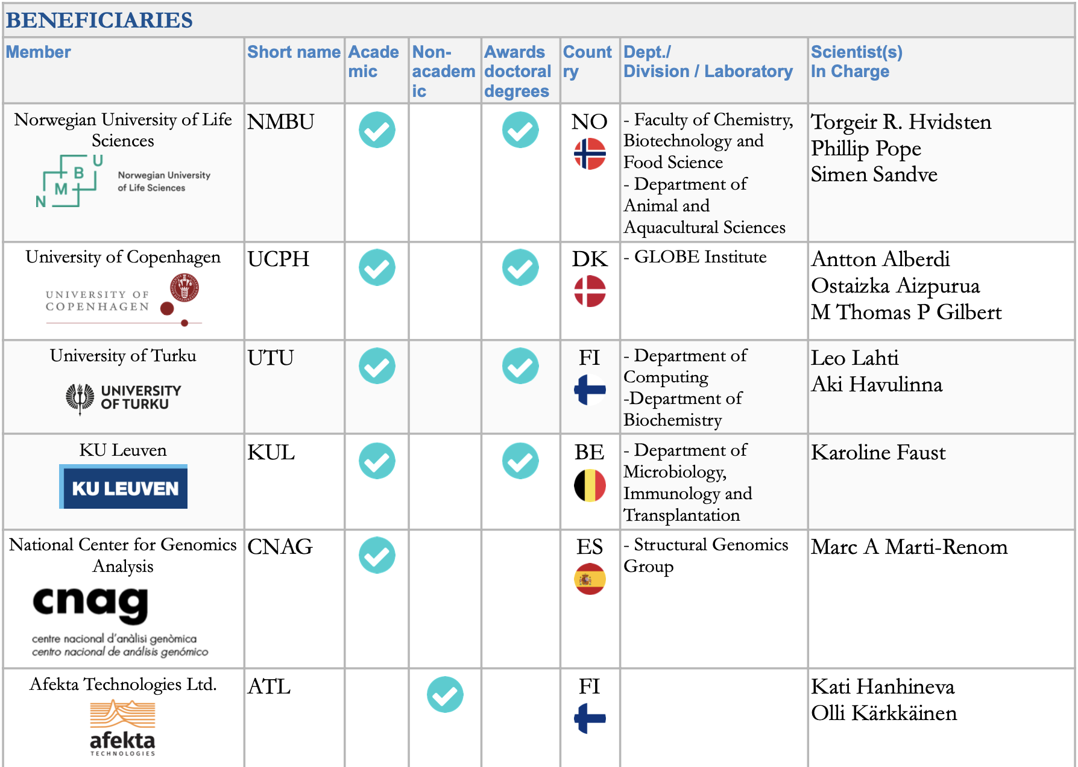

www.hologen-network.eu
PI: field, role, mobility
PhD-student: education, country, hobby
Gareth Difford
Sabina Leanti La Rosa
Doctoral Candidate | Name | Beneficiary
DC1 | Veronica Quarato | NMBU
DC2 | Sneha Das | UTU
DC3 |  | CNAG
DC4 | Adedamola Godwin Daodu | KUL
DC5 | Lucas Padilha | UCPH
DC6 |  | ATL
DC7 | Elsa Brenner | UCPH
DC8 | Emmanuel Okoli Odah | NMBU
DC9 | Katerina Katirtzoglou | NMBU
DC10 | Joao Paulo Cassucci dos Santos | UTU
DC11 |  | UB

Slide 10
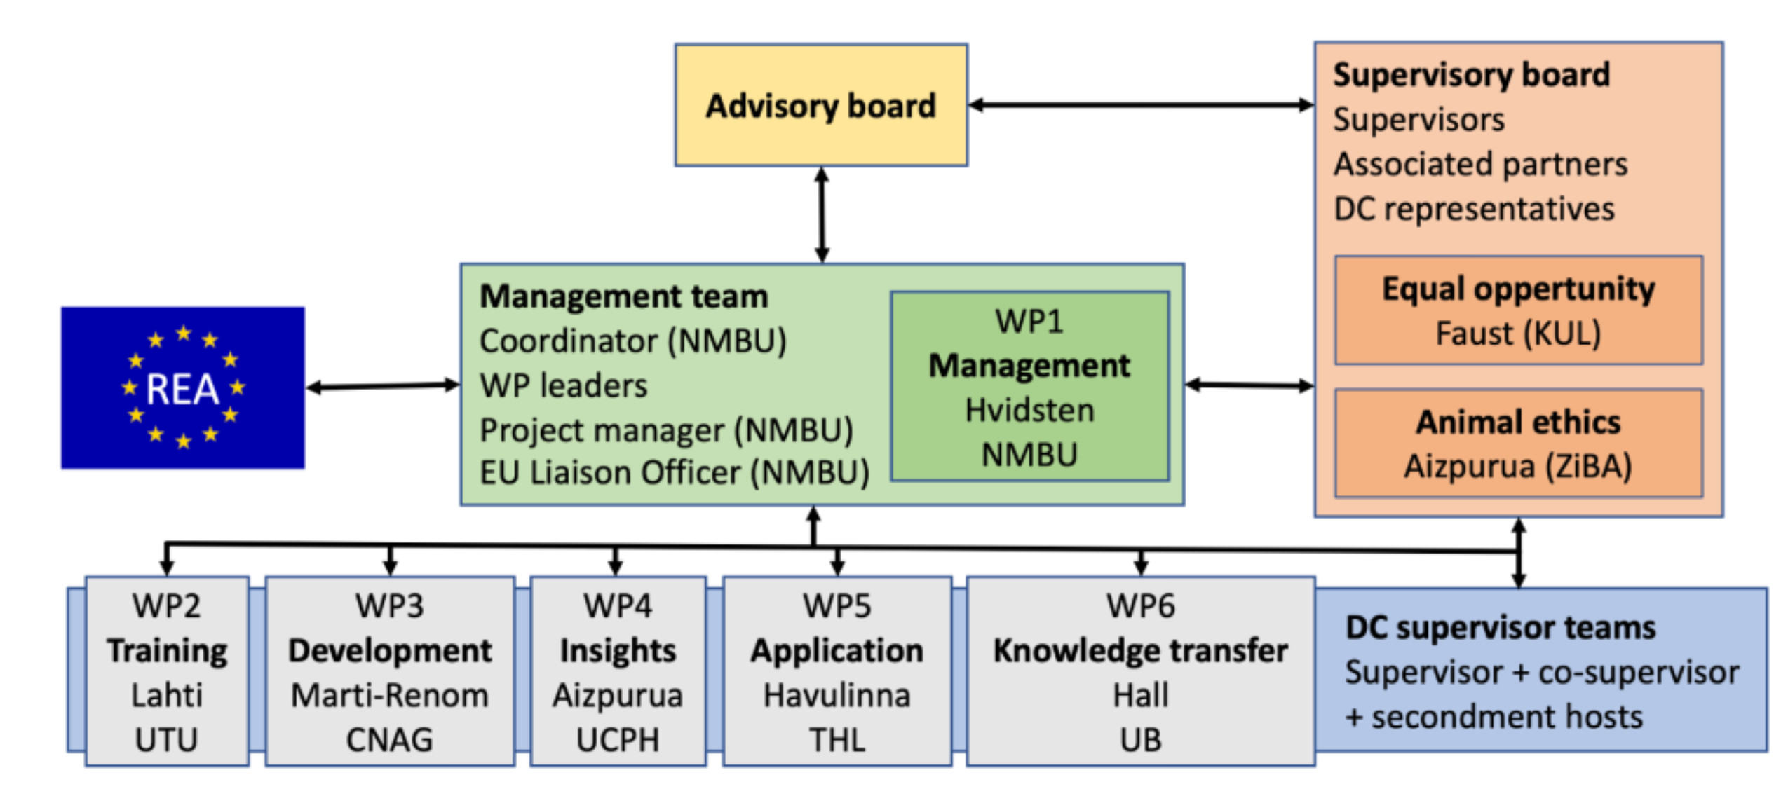

Slide 11
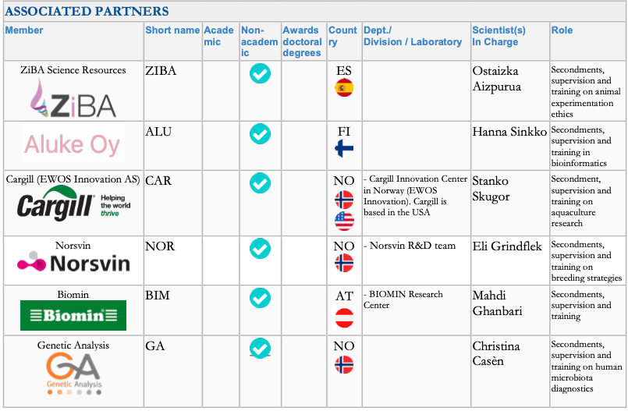
www.hologen-network.eu
Antti Karkman
Pranvera Hiseni

Slide 12
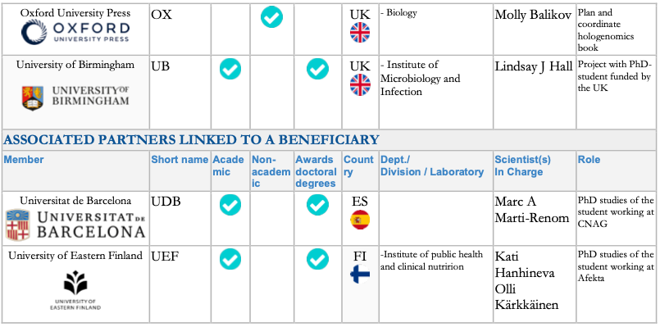
www.hologen-network.eu

Slide 13

www.hologen-network.eu
HoloGen Drive
https://tinyurl.com/HoloGenDrive
Grant Agreement
Consortium Agreement
Folders
                Deliverables
                TrainingEvents
HoloGen in a nutshell

Slide 14
www.hologen-network.eu
Organization
WP | Title | Leader | Beneficiary | Start | End
WP1 | Management | Hvidsten | NMBU | M1 | M48
WP2 | Training (TO1-3) | Lahti | UTU | M7 | M48
WP3 | Research: Development (RO1) | Marti-Renom | CNAG | M7 | M48
WP4 | Research: Fundamental insights (RO2) | Aizpurua | UCPH | M7 | M48
WP5 | Research: Application (RO3) | Havulinna | UTU | M7 | M48
WP6 | Knowledge transfer | Hall | UB | M1 | M48
 | Dissemination | Hanhineva | ATL
 | Exploitation | Sandve | NMBU
 | Communication | Hall | UB
WP7 | Ethics | Hvidsten | NMBU | M1 | M48

Slide 15
www.hologen-network.eu
PhD projects
DC1 - Multi-omic data integration with network analysis
DC2 - Multi-omic data integration with latent variable models
DC3 - Hologenomic insights into host-microbiota three-dimensional organisation
DC4 - In vitro investigation of host-microbiota dynamics in the human gut
DC5 - Elucidating the effect of functional microbiome attributes in vertebrate dietary shifts
DC6 - Longitudinal hologenomic dynamics of host-microbiota interactions
DC7 - Hologenomic underpinnings of animal behaviour
DC8 - Linking gut microbial communities to feed efficiency in Atlantic salmon
DC9 - Feed-microbiome-host interactions in production animals
DC10 - Geospatial variation in human hologenomics profiles
DC11 - Early life microbiota-host interactions
Development
(WP3)
Fundamental
insigths (WP4)
Application
(WP3)

Slide 16
www.hologen-network.eu
Supervisors and secondments
WP | DC | Main supervisor | Co-supervisor | Secondment host | Month | Duration | Industry host
WP3 | DC1 | Hvidsten | Lahti | Gilbert | early 2nd year | 3 | Aluke Oy
 | DC2 | Lahti | Hvidsten | Hall | late 2nd or early 3rd year | 3 | Aluke Oy
 | DC3 | Marti-Renom | Alberdi | Hanhineva | 28-31 | 3 | Afekta
WP4 | DC4 | Faust | Pope | Hanhineva | 28-34 | 3-4 | Afekta
 | DC5 | Alberdi | Havulinna | Faust | 3rd year | 4 | Biomin
 | DC6 | Hanhineva | Sandve | Aizpurua | 1st year | 4 | ZiBA
 | DC7 | Aizpurua | Gilbert | Hanhineva | 2nd year | 3 | Afekta
WP5 | DC8 | Sandve | Hall | Alberdi |  | 3 | Cargill
 | DC9 | Pope | Hall | Marti-Renom | beginning of the second year | 4 | Norsvin
 | DC10 | Havulinna | Alberdi | Sandve | 25-28 | 4 | Genetic Analysis
 | DC11 | Hall | Lahti | Pope | 2nd year | 3 | Genetic Analysis

Slide 17
www.hologen-network.eu
Milestones
# | Title | WP | Beneficiary | Due
1 | Consortium agreement | 1 | NMBU | M2 | Oct-24
2 | Recruitment of DCs | 1 | NMBU (All) | M12 | Aug-25
4 | All recruited DCs enrolled in PhD programme | 3-5 | UTU (All) | M12 | Aug-25
3 | Completion of Career Development Plans | 2 | UTU (All) | M13 | Sep-25
8 | Project mid-term check | 1 | NMBU | M15 | Nov-25
5 | Novel hologenomics software - beta versions | 3 | CNAG (NMBU/UTU) | M23 | Jul-26
6 | Finished data generation | 4 | UCPH (KUL/ATL) | M23 | Jul-26
7 | Finished initial analysis of data | 5 | THL (NMBU/UB) | M23 | Jul-26
9 | Novel hologenomics associations discovered using novel software and new insights from HoloGen | 3-5 | All | M42 | Feb-28
10 | Hologenomics day | 6 | UB (All) | M42 | Feb-28

Slide 18
www.hologen-network.eu
Career development plan (Template in Consortium Agreement)
BRIEF OVERVIEW OF RESEARCH PROJECT AND MAJOR ACCOMPLISHMENTS EXPECTED
(half page should besufficient):
LONG-TERM CAREER OBJECTIVES (over 5 years):
1. Goals:
2. What further research activity or other training is needed to attain these goals?
SHORT-TERM OBJECTIVES (1-2 years):
Research results: Anticipated publications/conference/courses/…
Research Skills and techniques: Training/technical expertise/…
Research management: grants written/applied for/travel awards/…
Communication skills
Other professional training (course work, teaching activity)
Anticipated networking opportunities
Other activities (community, etc) with professional relevance

Slide 19
www.hologen-network.eu
WP3: Scientific deliverables
# | Title/Description | WP | Beneficiary | Level | Due
D3.1 | DC1-3: Individual Research Programmes | WP3 | CNAG (NMBU/UTU) | Public | M12 | Aug-25
D3.2 | DC1: Network analysis software: beta version in Git repo | WP3 | NMBU | Public | M23 | Jul-26
D3.3 | DC2: Latent variable software: beta version in Git repo | WP3 | UTU | Public | M23 | Jul-26
D3.4 | DC3: 3D-omics software: beta version in Git repo | WP3 | CNAG | Public | M23 | Jul-26
D3.5 | DC1-3: Novel hologenomics software v1.0 | WP3 | CNAG (NMBU/UTU) | Public | M42 | Feb-28
D3.6 | DC1-3: Secondment report | WP3 | CNAG (NMBU/UTU) | Sensitive | M48 | Aug-28
D3.7 | DC1-3: PhD thesis reports | WP3 | CNAG (NMBU/UTU) | Sensitive | M48 | Aug-28

Slide 20
www.hologen-network.eu
WP4: Scientific deliverables
# | Title/Description | Beneficiary | Level | Due
D4.1 | DC4-7: Individual Research Programmes | UCPH (KUL/ATL) | Public | M12 | Aug-25
D4.2 | DC4: Data set on microbial abundances in bioreactors connected in different network configurations | KUL | Public | M23 | Jul-26
D4.3 | DC5: Microbial metagenomic data from the captivity experiments | UCPH | Public | M23 | Jul-26
D4.4 | DC6: Multi-omics data ready for analysis | ATL | Public | M23 | Jul-26
D4.5 | DC7: Paired behavioural and hologenomic data generated | UCPH | Public | M23 | Jul-26
D4.6 | DC4: Mathematical model of microbial interactions | KUL | Public | M42 | Feb-28
D4.7 | DC5: Preprint on the impact of gut microorganisms in dietary shifts in lizards | UCPH | Public | M42 | Feb-28
D4.8 | DC6: Preprint on the impact of environment on microbes | ATL | Public | M42 | Feb-28
D4.9 | DC7: List of hologenomic associations with behaviour | UCPH | Public | M42 | Feb-28
D4.10 | DCs 4-7: Secondment report | UCPH (KUL/ATL) | Sensitive | M48 | Aug-28
D4.11 | DCs 4-7: PhD thesis reports | UCPH (KUL/ATL) | Sensitive | M48 | Aug-28

Slide 21
www.hologen-network.eu
WP5: Scientific deliverables
# | Title/Description | Beneficiary | Level | Due
D5.1 | DC8-11: Individual Research Programmes | THL (NMBU/UB) | Public | M12 | Aug-25
D5.2 | DC8: Finish data generation of microbial genomics and feed efficiency | NMBU | Public | M23 | Jul-26
D5.3 | DC9: Preprint on analysis of hologenome reconstructions | NMBU | Public | M23 | Jul-26
D5.4 | DC10: Preprint on geographic differences in gut microbial profiles | THL | Public | M23 | Jul-26
D5.5 | DC11: Finished analysis of PEARL data and sample selection for proteomics | UB | Sensitive | M23 | Jul-26
D5.6 | DC8-11: Lists of hologenomic associations with animal production and human health | THL (NMBU/UB) | Public | M42 | Feb-28
D5.7 | DC8-11: Secondment report | THL (NMBU/UB) | Sensitive | M48 | Aug-28
D5.8 | DC8-11: PhD thesis reports | THL (NMBU/UB) | Sensitive | M48 | Aug-28

Slide 22
www.hologen-network.eu
Administrative deliverables
# | Title/Description | WP | Beneficiary | Level | Due
D1.1 | Supervisory Board of the network | WP1 | NMBU | Sensitive | M2 | Oct-24
D1.2 | Website | WP1 | NMBU | Public | M2 | Oct-24
D1.3 | Data Management Plan | WP1 | NMBU | Sensitive | M13 | Sep-25
D1.4 | Progress report | WP1 | NMBU | Sensitive | M13 | Sep-25
D1.5 | Final report | WP1 | NMBU | Sensitive | M48 | Aug-28
D2.1 | Open online resource for training materials | WP2 | UTU | Public | M7 | Mar-25
D2.2 | Career Development Plans | WP2 | UTU (All) | Sensitive | M13 | Sep-25
D2.3 | Mid-term training report | WP2 | UTU | Sensitive | M24 | Aug-26
D2.4 | Final training report | WP2 | UTU | Sensitive | M48 | Aug-28
D6.1 | Plan for the dissemination and exploitation of results, including communication activities 1 | WP6 | UB | Sensitive | M13 | Sep-25
D6.2 | Plan for the dissemination and exploitation of results, including communication activities 2 | WP6 | UB | Sensitive | M48 | Aug-28
D7.1 | Requirement no. 1 | WP7 | NMBU | Sensitive | M2 | Oct-24
D7.2 | Requirement no. 2 | WP7 | NMBU | Sensitive | M24 | Aug-26
D7.3 | Requirement no. 3 | WP7 | NMBU | Sensitive | M48 | Aug-28

Slide 23
www.hologen-network.eu
Training and networking events
# | Main training events and conferences | ECTS | Leader | Month | Time
T1 | Training and Networking Retreat 1: Introduction | 2 | UCPH | 7 | Mar-25
T2 | Training and Networking Retreat 2: High-Throughput Profiling | 2 | NMBU | 13 | Sep-25
T3 | SMBE 2026 session on hologenomics (conditional on acceptance by the SMBE board) |  | CNAG | 19
T4 | Training and Networking Retreat 3: Data analysis and Open Science | 2 | UTU | 20 | Apr-26
T5 | ECCB 2026 session on hologenomics (conditional on acceptance by the ECCB board) |  | UTU | 22
T6 | Training and Networking Retreat 4: Dissemination, Exploitation and Communication | 2 | KUL | 26 | Oct-26
T7 | ESEB 2027 session on hologenomics (conditional on acceptance by the ESEB board) |  | UCPH | 31
T8 | Training and Networking Retreat 5: Career Development | 2 | CNAG | 33 | May-27
T9 | Hologenomics Conference | 2 | UCPH | 36 | Aug-27
T10 | Hologenomics Day | 1 | UB | 42 | Feb-28
T11 | Final meeting: presentation of results and future prospects | 2 | UB | 42 | Feb-28

Slide 24
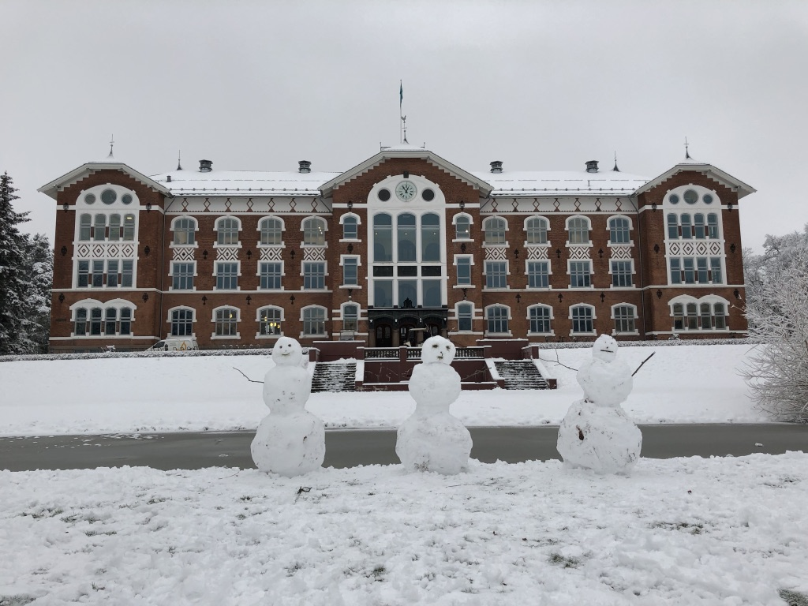
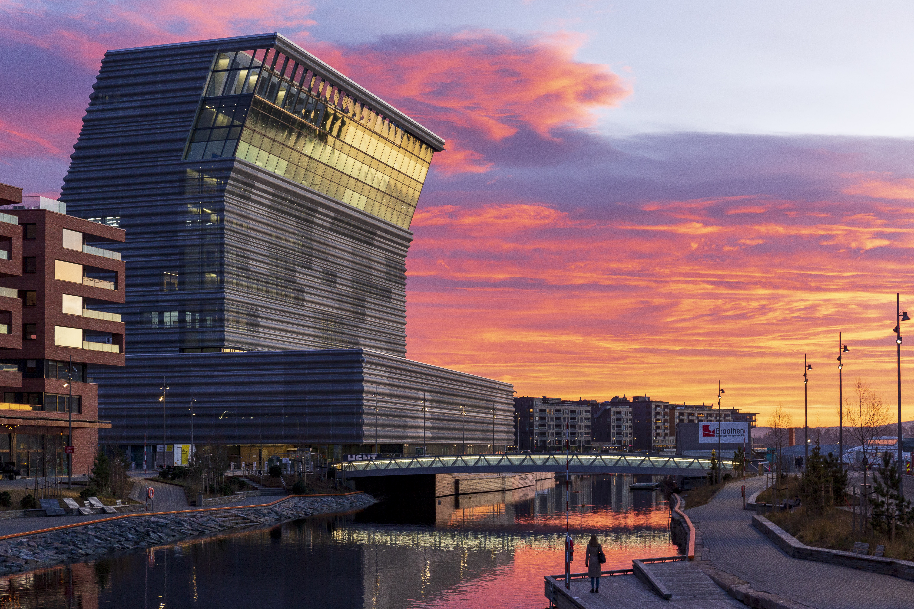
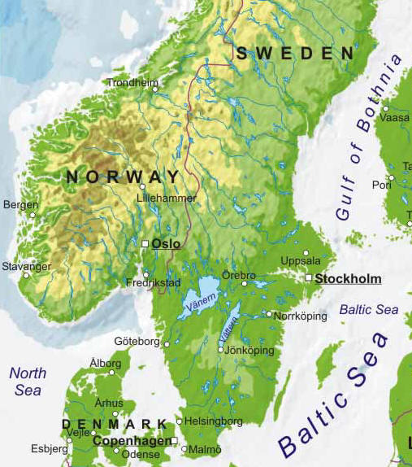
www.hologen-network.eu
Training and Networking Retreat 2: Oslo!
November 10-14
Norwegian University of Life Sciences

Slide 25
www.hologen-network.eu
MSCA green charter
The MSCA Green Charter promotes the sustainable implementation of research activities: minimise the environmental impact of research activities
All participants are expected to adhere to the Green Charter on a "best effort" basis
Some measures to consider:
reduce, reuse and recycle
promote green purchasing for project-related materials
ensure the sustainability of project events
use low-emission forms of transport
promote teleconferencing whenever possible
use sustainable and renewable forms of energy
develop awareness on environmental sustainability
share ideas and examples of best practice

